Slide 1

THERMODYNAMICS I (ME 265)
FIRST LAW OF THERMODYNAMICS
APPLIED TO CLOSED AND OPENED SYSTEMS
Francis Kofi Forson (Professor)
Department of Mechanical Engineering
Kwame Nkrumah University of Science and Technology, Kumasi, Ghana

Slide 2
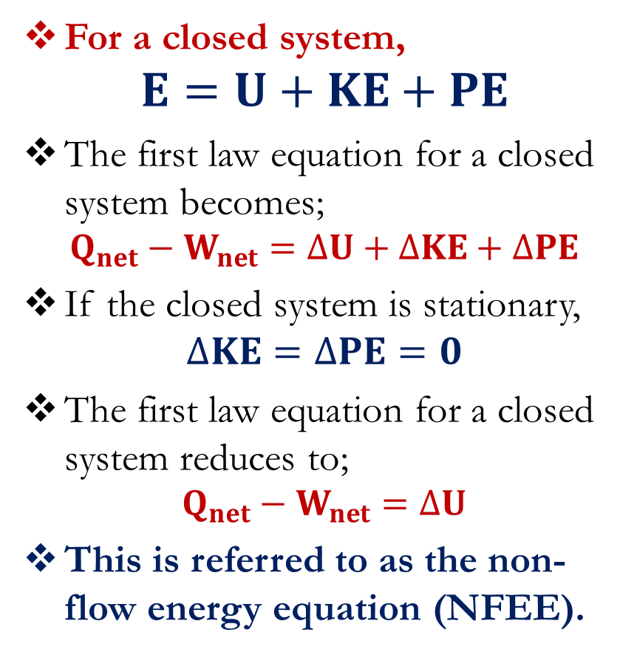
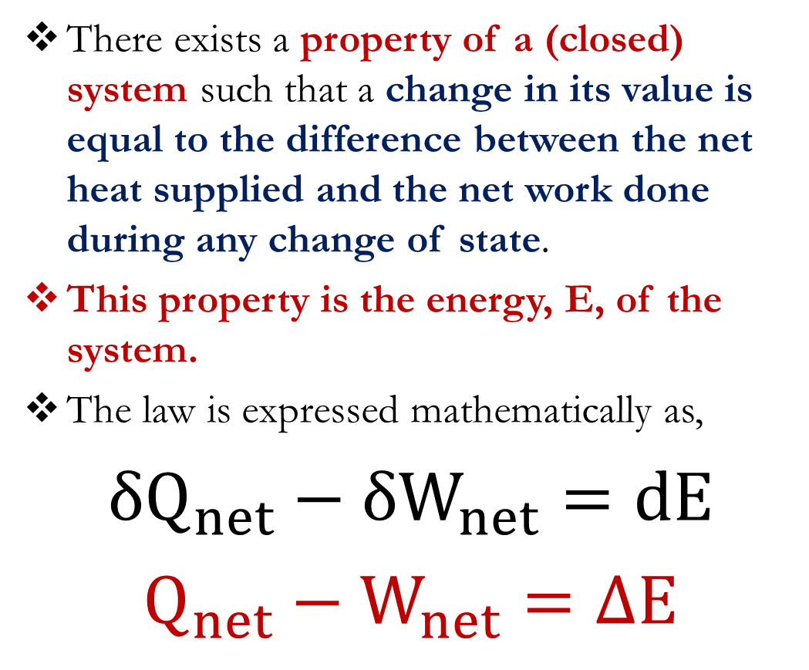
First Law of Thermodynamics
There exists a property of a (closed) system such that a change in its value is equal to the difference between the net heat supplied and the net work done during any change of state.
This property is the energy, E, of the system.
The law is expressed mathematically as,
$${δQ}_{net}−{δW}_{net}=dE$$
$$Q_{net}−W_{net}=∆E$$
For a closed system,
$$E=U+KE+PE$$
The first law equation for a closed system becomes;
$$Q_{net}−W_{net}=∆U+∆KE+∆PE$$
If the closed system is stationary,
$$∆KE=∆PE=0$$
The first law equation for a closed system reduces to;
$$Q_{net}−W_{net}=∆U$$
This is referred to as the non-flow energy equation (NFEE).

Slide 3
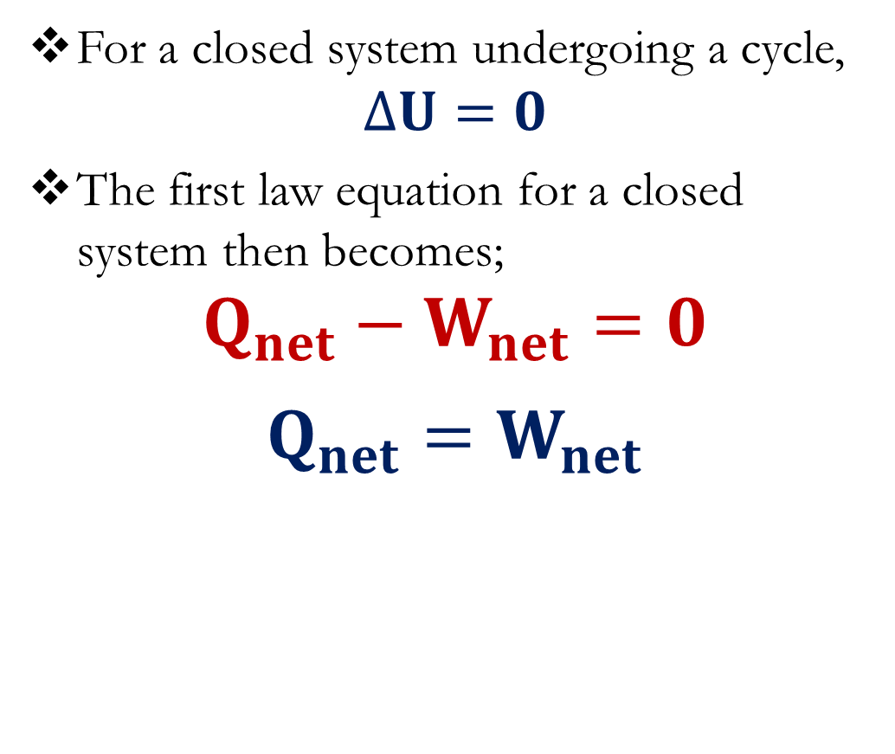
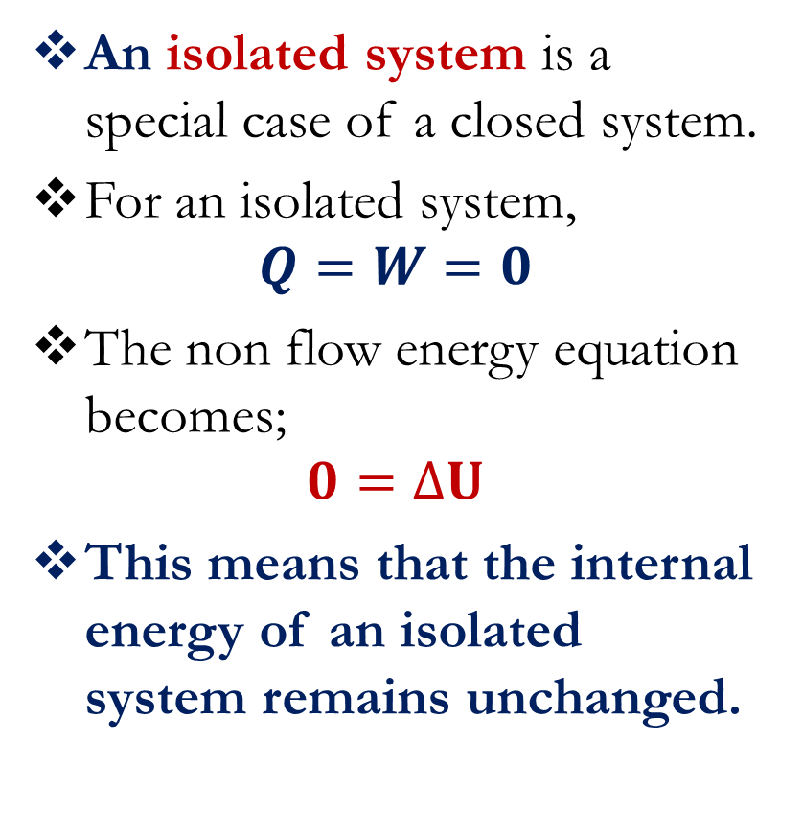
First Law of Thermodynamics
An isolated system is a special case of a closed system.
For an isolated system,
$$Q=W=0$$
The non flow energy equation becomes;
$$0=∆U$$
This means that the internal energy of an isolated system remains unchanged.
For a closed system undergoing a cycle,
$$∆U=0$$
The first law equation for a closed system then becomes;
$$Q_{net}−W_{net}=0$$
$$Q_{net}=W_{net}$$

Slide 4
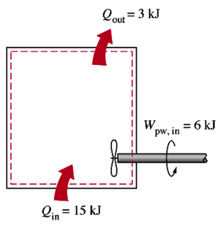
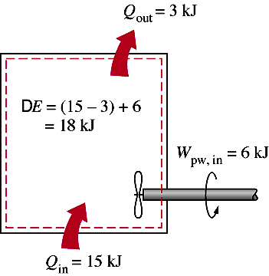


First Law of Thermodynamics
Example 1
Solution

Slide 5
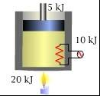
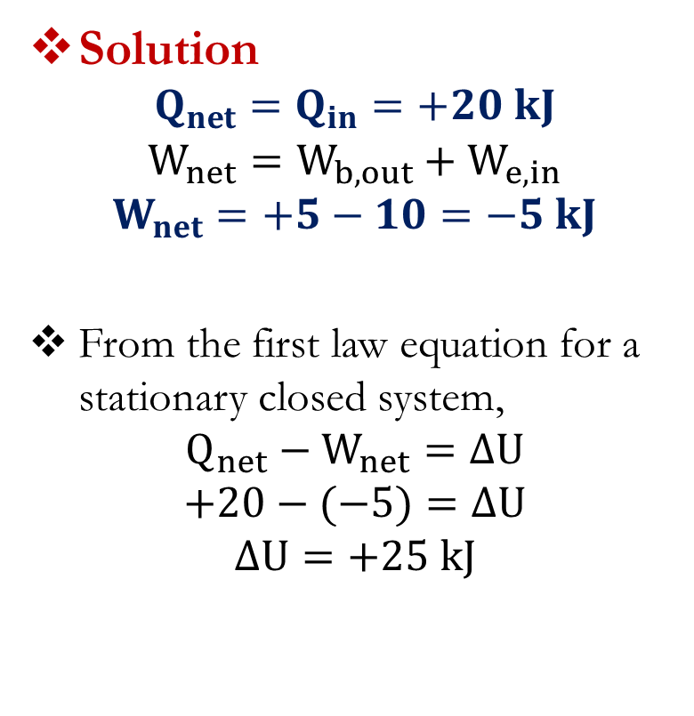
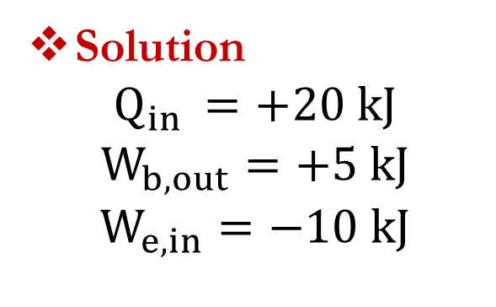
First Law of Thermodynamics
Example 2
A gas trapped inside a piston-cylinder device receives 20 kJ of heat while it expands performing a boundary work of 5 kJ. At the same time, 10 kJ of electrical work is transferred into the system. Evaluate Q, W and ΔU with appropriate signs.
Solution
$$Q_{net}=Q_{in}=+20 kJ$$
$$W_{net}=W_{b,out}+W_{e,in}$$
$$W_{net}=+5−10=−5 kJ$$
From the first law equation for a stationary closed system,
$$Q_{net}−W_{net}=∆U$$
$$+20−(−5)=∆U$$
$$∆U=+25 kJ$$
Solution
$$Q_{in }=+20 kJ$$
$$W_{b, out}=+5 kJ$$
$$W_{e, in}=−10 kJ$$

Slide 6
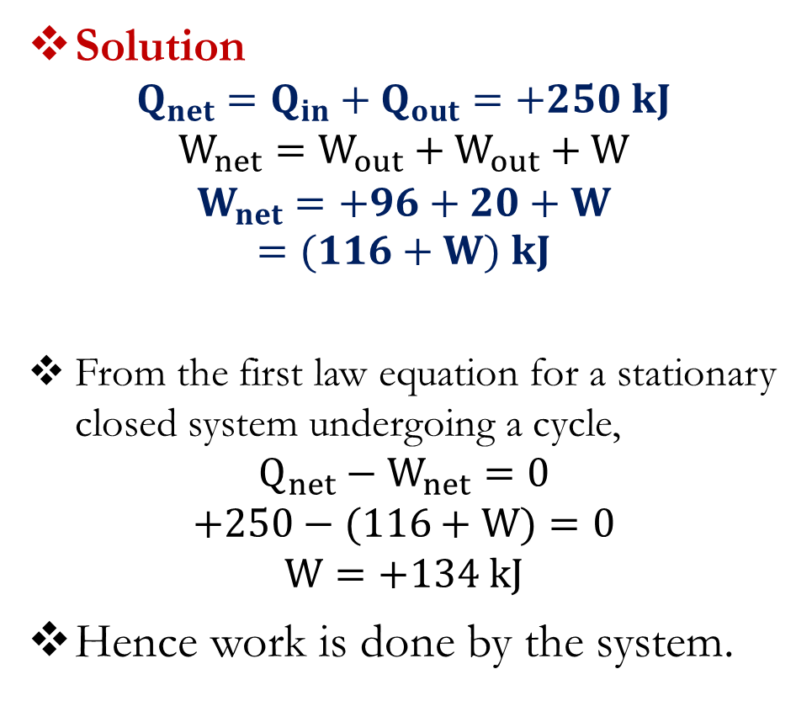
First Law of Thermodynamics
Solution
$$Q_{net}=Q_{in}+Q_{out}=+250 kJ$$
$$W_{net}=W_{out}+W_{out}+W$$
$$W_{net}=+96+20+W$$
$$=(116+W) kJ$$
From the first law equation for a stationary closed system undergoing a cycle,
$$Q_{net}−W_{net}=0$$
$$+250−(116+W)=0$$
$$W=+134 kJ$$
Hence work is done by the system.
Example 3
During a complete cycle of operations, a system is subjected to the following heat transfers; 800 kJ supplied and 550 kJ rejected. At two points, work is done by the system to the extent of 96 kNm and 20 kNm. At a third point, there is a further work transfer.
Determine its amount and state whether it is work done by or on the system.

Slide 7
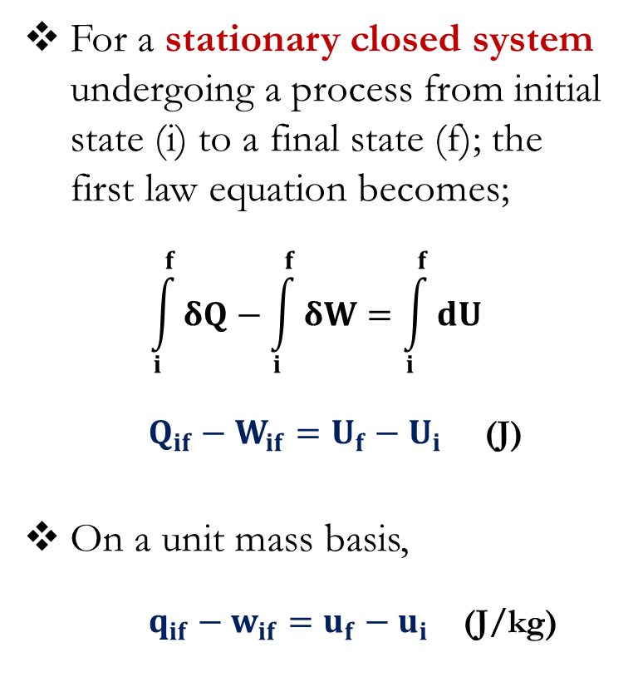
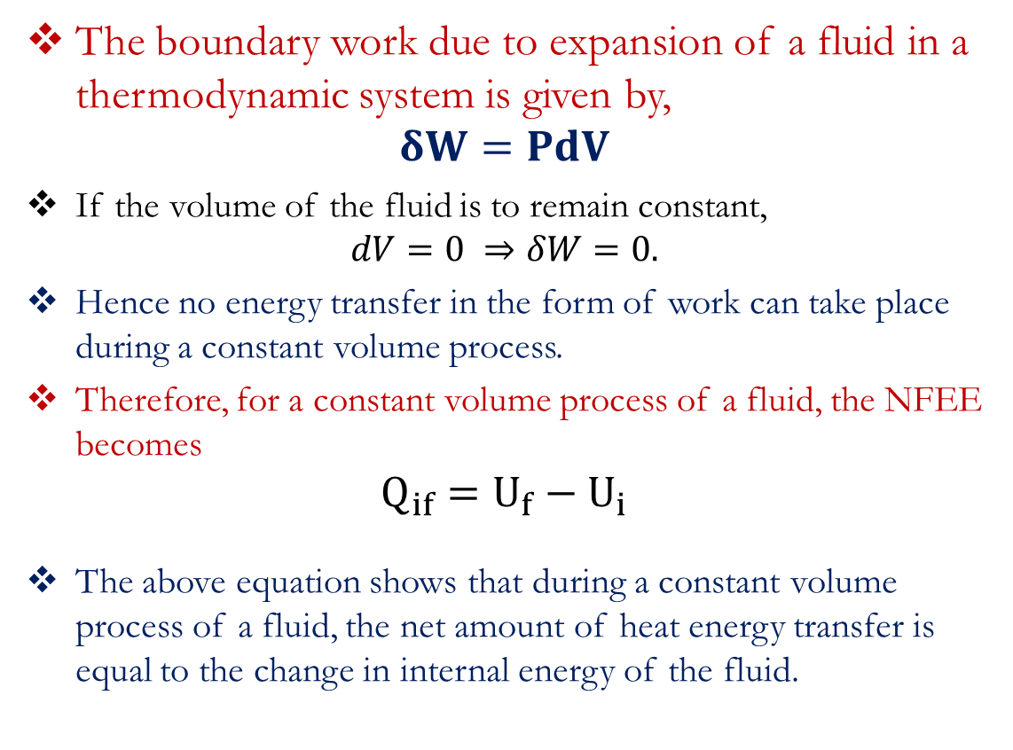
First Law of Thermodynamics
For a stationary closed system undergoing a process from initial state (i) to a final state (f); the first law equation becomes;
$$\int_{i}^{f}{δQ−\int_{i}^{f}{δW=\int_{i}^{f}{dU}}}$$
$Q_{if}−W_{if}=U_{f}−U_{i}$ (J)
On a unit mass basis,
$q_{if}−w_{if}=u_{f}−u_{i}$ (J/kg)
The boundary work due to expansion of a fluid in a thermodynamic system is given by,
$$δW=PdV$$
If the volume of the fluid is to remain constant,
$$dV=0 ⇒δW=0.$$
Hence no energy transfer in the form of work can take place during a constant volume process.
Therefore, for a constant volume process of a fluid, the NFEE becomes
$$Q_{if}=U_{f}−U_{i}$$
The above equation shows that during a constant volume process of a fluid, the net amount of heat energy transfer is equal to the change in internal energy of the fluid.

Slide 8
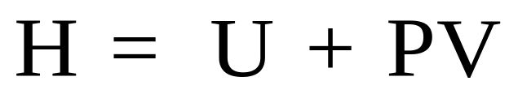
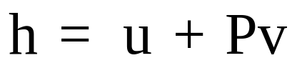
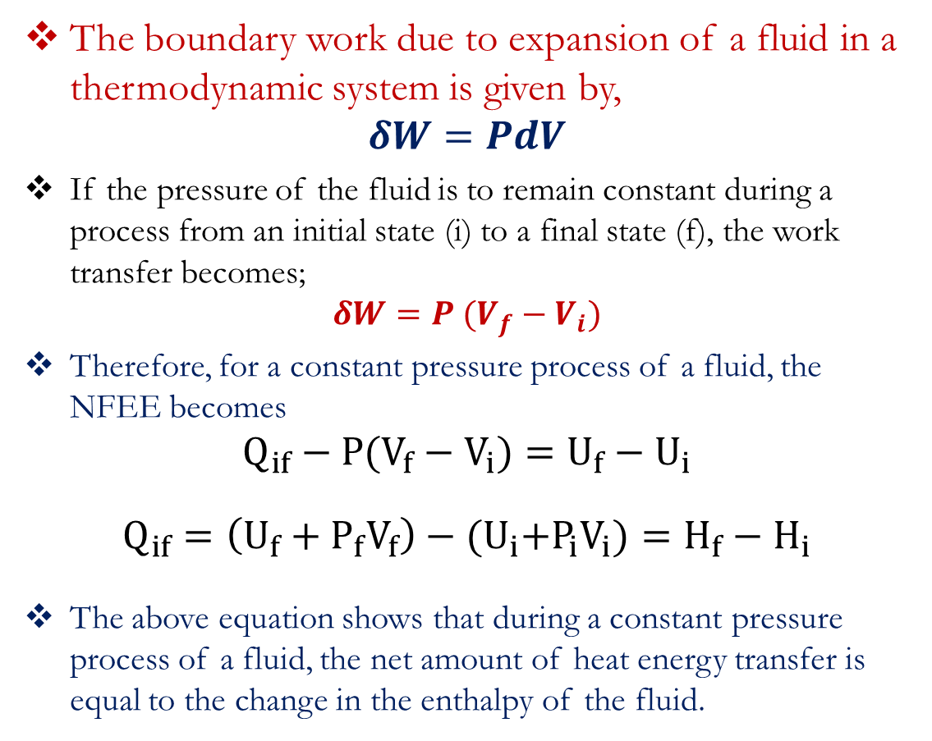
First Law of Thermodynamics
In thermodynamics, it is common to group properties when they appear consistently. A name is then given to the group.
One of such group is a property called enthalpy (H).
For specific enthalpy (enthalpy per unit mass),
The boundary work due to expansion of a fluid in a thermodynamic system is given by,
$$δW=PdV$$
If the pressure of the fluid is to remain constant during a process from an initial state (i) to a final state (f), the work transfer becomes;
$$δW=P (V_{f}−V_{i})$$
Therefore, for a constant pressure process of a fluid, the NFEE becomes
$$Q_{if}−P(V_{f}−V_{i})=U_{f}−U_{i}$$
$$Q_{if}=\left(U_{f}+P_{f}V_{f}\right)−{(U}_{i}+P_{i}V_{i})=H_{f}−H_{i}$$
The above equation shows that during a constant pressure process of a fluid, the net amount of heat energy transfer is equal to the change in the enthalpy of the fluid.

Slide 9
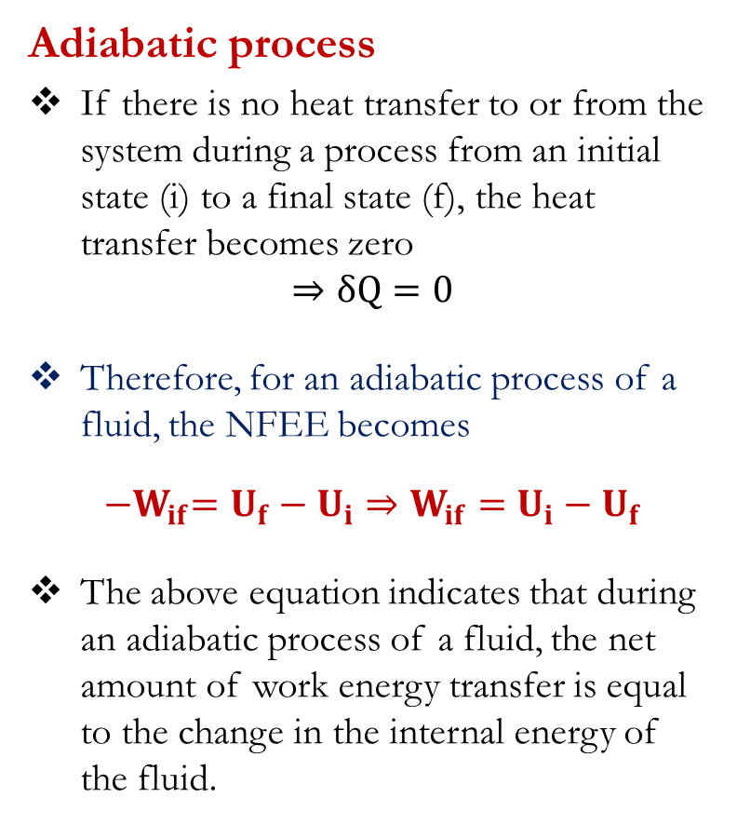
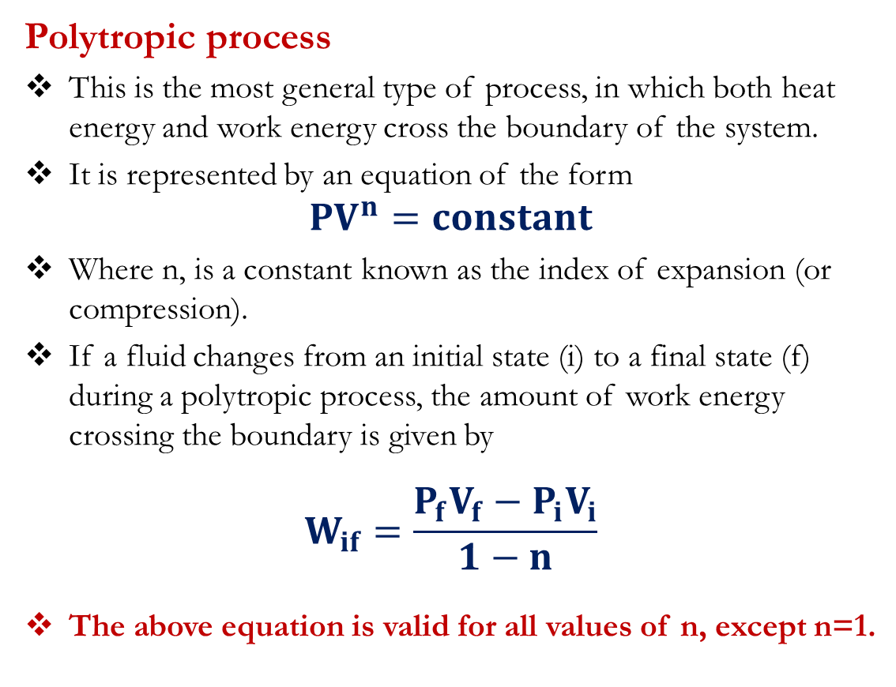
First Law of Thermodynamics
Adiabatic process
If there is no heat transfer to or from the system during a process from an initial state (i) to a final state (f), the heat transfer becomes zero
$$⇒δQ=0$$
Therefore, for an adiabatic process of a fluid, the NFEE becomes
$${−W}_{if}=U_{f}−U_{i}⇒W_{if}=U_{i}−U_{f}$$
The above equation indicates that during an adiabatic process of a fluid, the net amount of work energy transfer is equal to the change in the internal energy of the fluid.
Polytropic process
This is the most general type of process, in which both heat energy and work energy cross the boundary of the system.
It is represented by an equation of the form
$${PV}^{n}=constant$$
Where n, is a constant known as the index of expansion (or compression).
If a fluid changes from an initial state (i) to a final state (f) during a polytropic process, the amount of work energy crossing the boundary is given by
$$W_{if}=\frac{P_{f}V_{f}−P_{i}V_{i}}{1−n}$$
The above equation is valid for all values of n, except n=1.

Slide 10
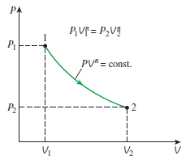
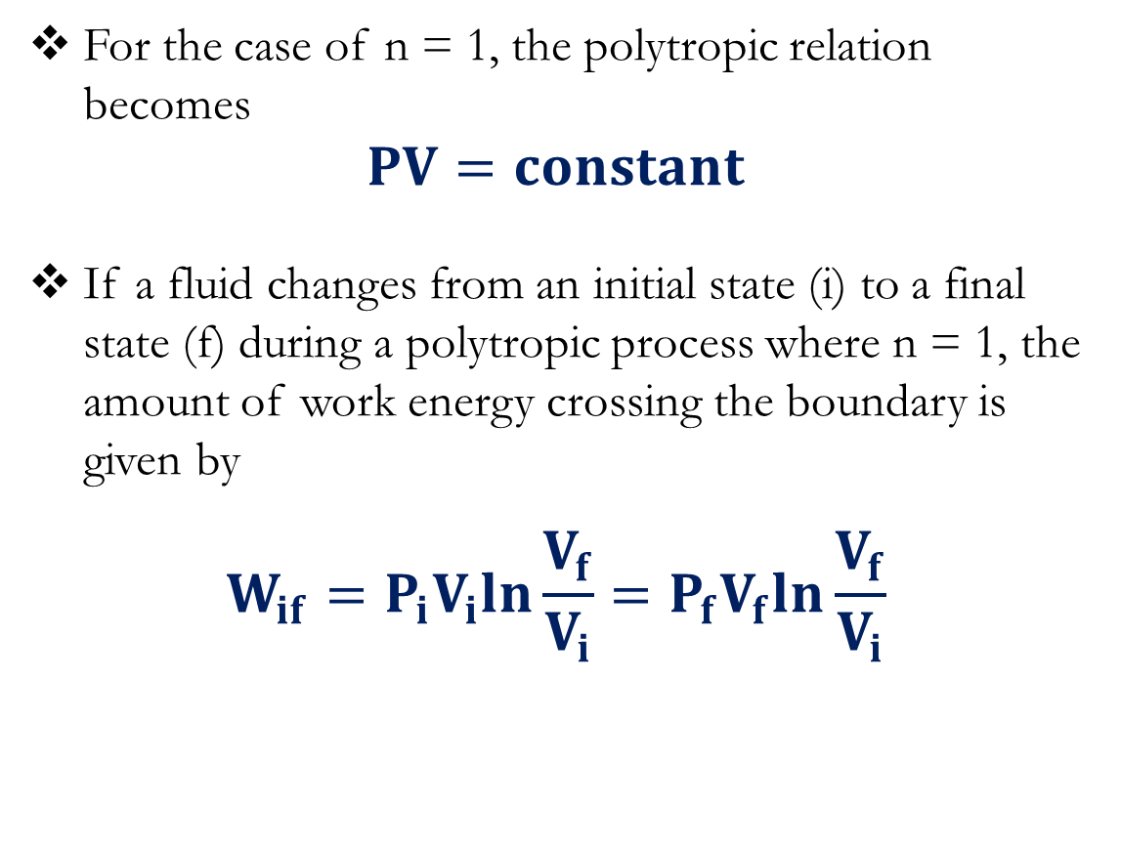
First Law of Thermodynamics
Polytropic process
A plot of pressure against volume for a polytropic process.
For the case of n = 1, the polytropic relation becomes
$$PV=constant$$
If a fluid changes from an initial state (i) to a final state (f) during a polytropic process where n = 1, the amount of work energy crossing the boundary is given by
$$W_{if}=P_{i}V_{i}ln\frac{V_{f}}{V_{i}}=P_{f}V_{f}ln\frac{V_{f}}{V_{i}}$$

Slide 11
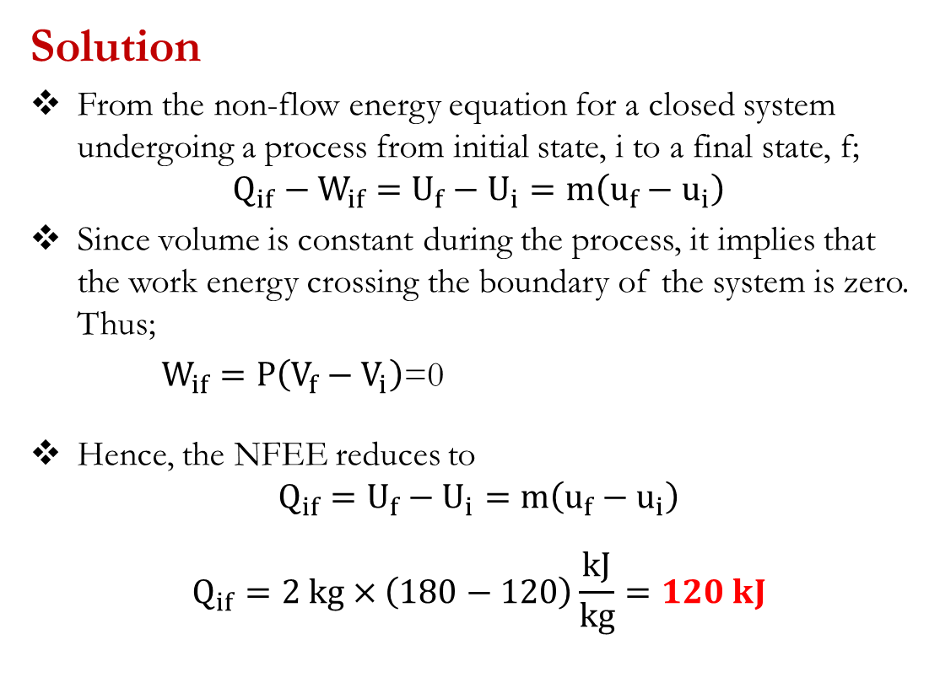
First Law for Closed Systems: Problems
Problem 1
The specific internal energy of a fluid is increased from 120 kJ/kg to 180 kJ/kg during a constant volume process. Determine the amount of heat energy required to bring about this increase for 2 kg of the fluid.
Suggested Answer: [120 kJ]
Solution
From the non-flow energy equation for a closed system undergoing a process from initial state, i to a final state, f;
$$Q_{if}−W_{if}=U_{f}−U_{i}=m\left(u_{f}−u_{i}\right)$$
Since volume is constant during the process, it implies that the work energy crossing the boundary of the system is zero. Thus;
$W_{if}=P\left(V_{f}−V_{i}\right)$=0
Hence, the NFEE reduces to
$$Q_{if}=U_{f}−U_{i}=m\left(u_{f}−u_{i}\right)$$
$$Q_{if}=2 kg×\left(180−120\right)\frac{kJ}{kg}=120 kJ$$

Slide 12
First Law for Closed Systems: Problems
Problem 2
2.25 kg of a fluid having a volume of 0.1 m³ are contained in a cylinder at a constant pressure of 7 bar. Heat energy is supplied to the fluid until the volume becomes 0.2 m³. If the initial and final specific enthalpies of the fluid are 210 kJ/kg and 280 kJ/kg, respectively, determine,
(a) the quantity of heat energy supplied to the fluid
(b) the change in internal energy of the fluid.
Suggested Answer: [(a) 157.5 kJ; (b) 87.5 kJ]

Slide 13
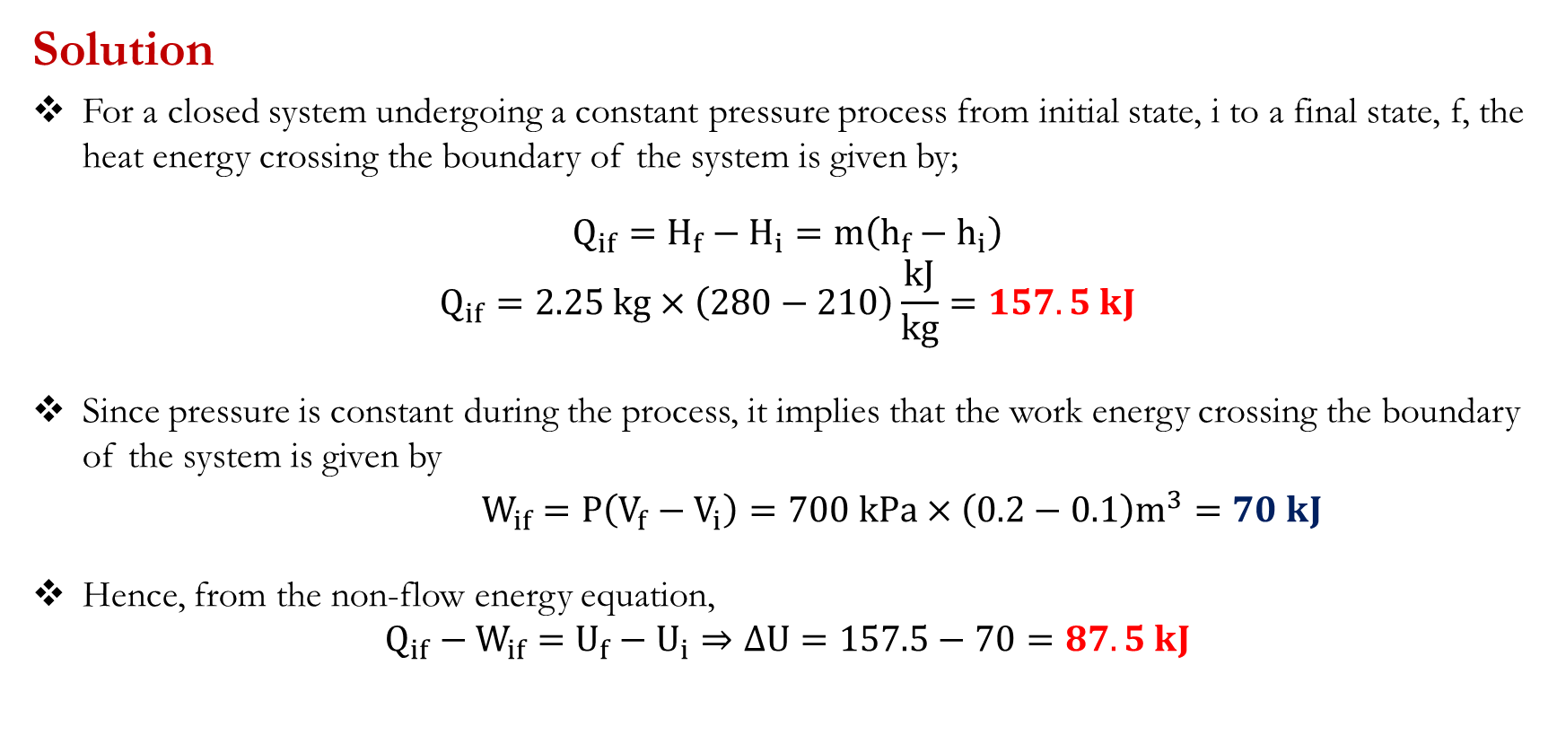
First Law for Closed Systems: Problems
Solution
For a closed system undergoing a constant pressure process from initial state, i to a final state, f, the heat energy crossing the boundary of the system is given by;
$$Q_{if}=H_{f}−H_{i}=m\left(h_{f}−h_{i}\right)$$
$$Q_{if}=2.25 kg×\left(280−210\right)\frac{kJ}{kg}=157.5 kJ$$
Since pressure is constant during the process, it implies that the work energy crossing the boundary of the system is given by
$W_{if}=P\left(V_{f}−V_{i}\right)=700 kPa×\left(0.2−0.1\right)m^{3}=70 kJ$
Hence, from the non-flow energy equation,
$$Q_{if}−W_{if}=U_{f}−U_{i}⇒∆U=157.5−70=87.5 kJ$$

Slide 14
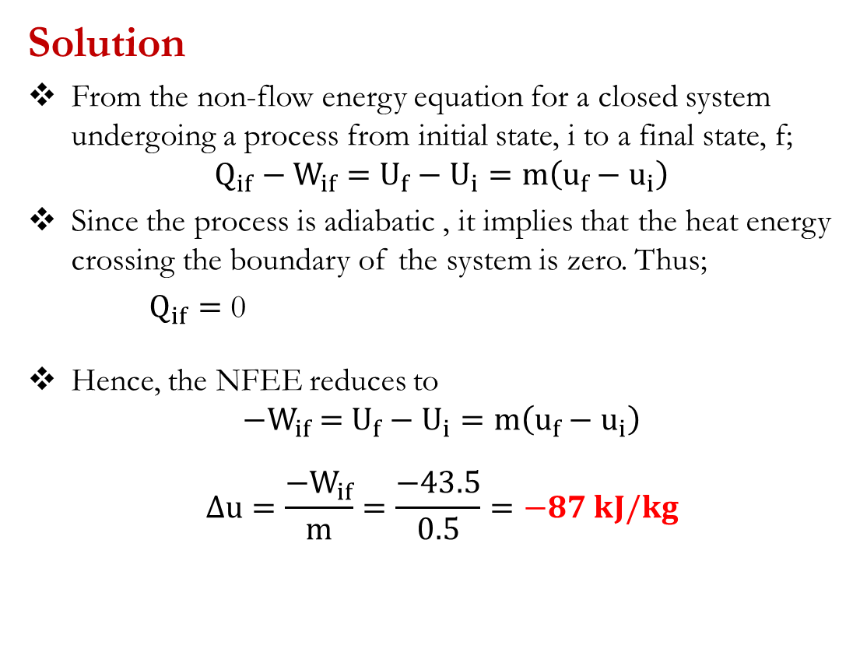
First Law for Closed Systems: Problems
Problem 3
During an adiabatic expansion process, 0.5 kg of fluid transfers 43.5 kJ of work energy. Determine the change in specific internal energy of the fluid during the process.
Suggested Answer: [-87 kJ/kg; The internal energy decreases during the process]
Solution
From the non-flow energy equation for a closed system undergoing a process from initial state, i to a final state, f;
$$Q_{if}−W_{if}=U_{f}−U_{i}=m\left(u_{f}−u_{i}\right)$$
Since the process is adiabatic , it implies that the heat energy crossing the boundary of the system is zero. Thus;
$Q_{if}=$ 0
Hence, the NFEE reduces to
$${−W}_{if} =U_{f}−U_{i}=m\left(u_{f}−u_{i}\right)$$
$$∆u=\frac{{−W}_{if}}{m}=\frac{−43.5}{0.5}=−87 kJ/kg$$

Slide 15
First Law for Closed Systems: Problems
Problem 4
A cylinder contains 0.07 kg of fluid having a pressure of 1 bar, a volume of 0.06 m³ and a specific internal energy of 200 kJ/kg. After polytropic compression, the pressure and volume of the fluid are 9 bar and 0.0111 m³, respectively, and the specific internal energy is 370 kJ/kg. Determine,
(a) the amount of work energy required for the compression
(b) the quantity and direction of heat energy flow during the compression.
Suggested Answers: [(a) -13.2 kJ; (b) -1.3 kJ]

Slide 16
First Law for Closed Systems: Problems
Problem 5
A piston–cylinder device containing 25 g of fluid expands at a constant pressure of 300 kPa. The initial specific enthalpy of the fluid is 2725kJ/kg. A resistance heater within the cylinder is turned on and passes a current of 0.2 A for 5 min from a 120-V source. At the same time, a heat loss of 3.7 kJ occurs. Determine the final specific enthalpy of the fluid.
Suggested Answer: [2865 kJ/kg]
Problem 6
A quantity of fluid occupies 0.56 m³ at 1 bar. After a compression which follows the law PV^{n} = constant, the pressure and the volume are 6.3 bar and 0.14 m³ respectively. Calculate the value of the index, n and the work energy transfer.
If the internal energy of the fluid increases by 85 kJ during the process, calculate the heat energy transfer.
Suggested Answers: [(a)1.328; -98.2 kJ; (b) -13.2 kJ]

Slide 17
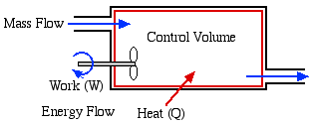
First Law of Thermodynamics: Open system
An open system (control volume) differs from a closed system in that it involves mass flow. Mass carries energy with it, and thus the mass and energy content of a system change when mass enters or leaves.

Slide 18
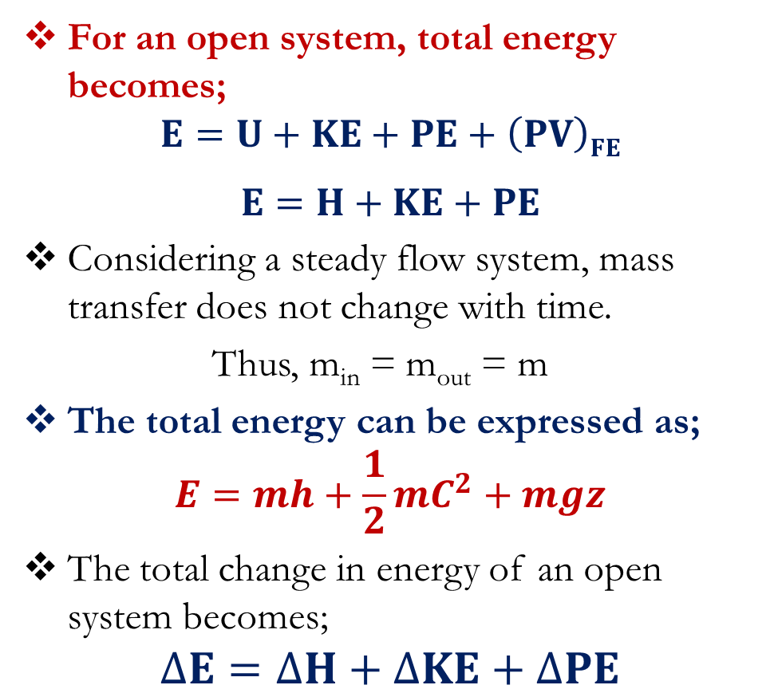
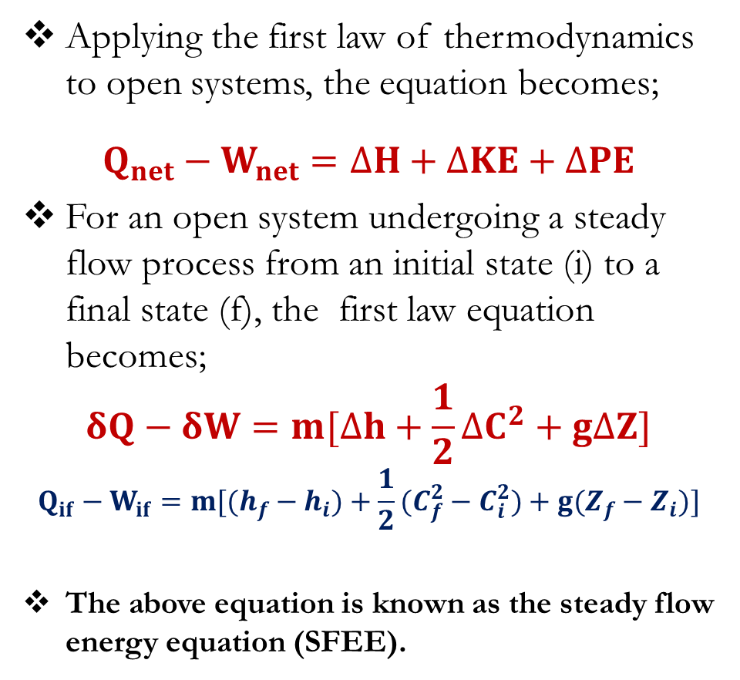
First Law of Thermodynamics: Open system
For an open system, total energy becomes;
$$E=U+KE+PE+\left(PV\right)FE$$
$$E=H+KE+PE$$
Considering a steady flow system, mass transfer does not change with time.
Thus, m_{in} = m_{out} = m
The total energy can be expressed as;
$$E=mh+\frac{1}{2}mC^{2}+mgz$$
The total change in energy of an open system becomes;
$$∆E=∆H+∆KE+∆PE$$
Applying the first law of thermodynamics to open systems, the equation becomes;
$$Q_{net}−W_{net}=∆H+∆KE+∆PE$$
For an open system undergoing a steady flow process from an initial state (i) to a final state (f), the first law equation becomes;
$$δQ−δW=m[∆h+\frac{1}{2}∆C^{2}+g∆Z]$$
$$Q_{if}−W_{if}=m[(h_{f}−h_{i})+\frac{1}{2}(C_{f}^{2}−C_{i}^{2})+g(Z_{f}−Z_{i})]$$
The above equation is known as the steady flow energy equation (SFEE).

Slide 19
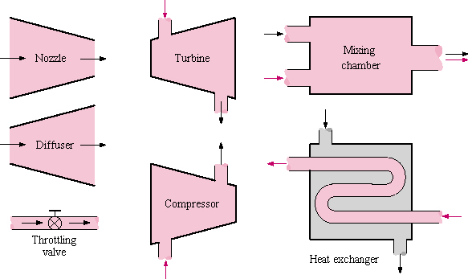
First Law of Thermodynamics: Open system
Most engineering devices such as turbines, compressors and nozzles operate for long periods of time under the same conditions, and they are classified as steady-flow devices.

Slide 20
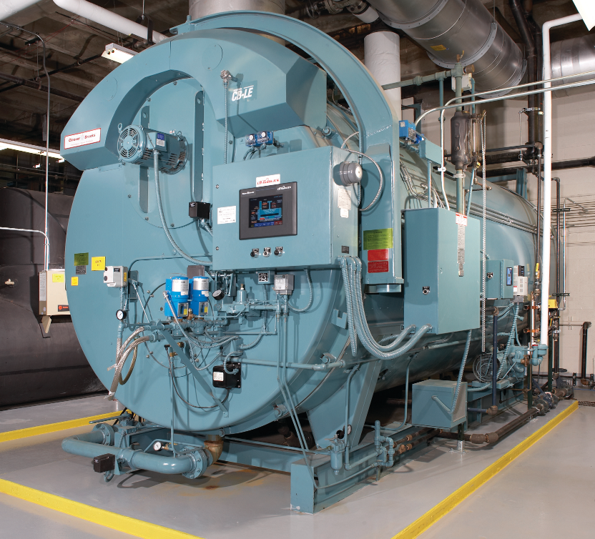
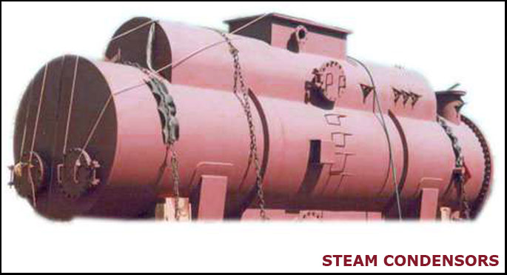
Applications of steady flow energy equation
Boilers and Condensers
In a boiler operating under steady conditions, water is pumped into the boiler along the feed line at the same rate at which steam leaves the boiler along the steam main, and heat energy is supplied from the furnace at steady rate.
In principle, a condenser is a boiler in reverse. Heat energy is removed in order to condense the vapour into a liquid.
If the condenser is in steady state, then the amount of liquid (condensate) must be equal to the amount of vapour entering the condenser.

Slide 21
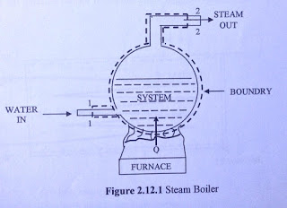
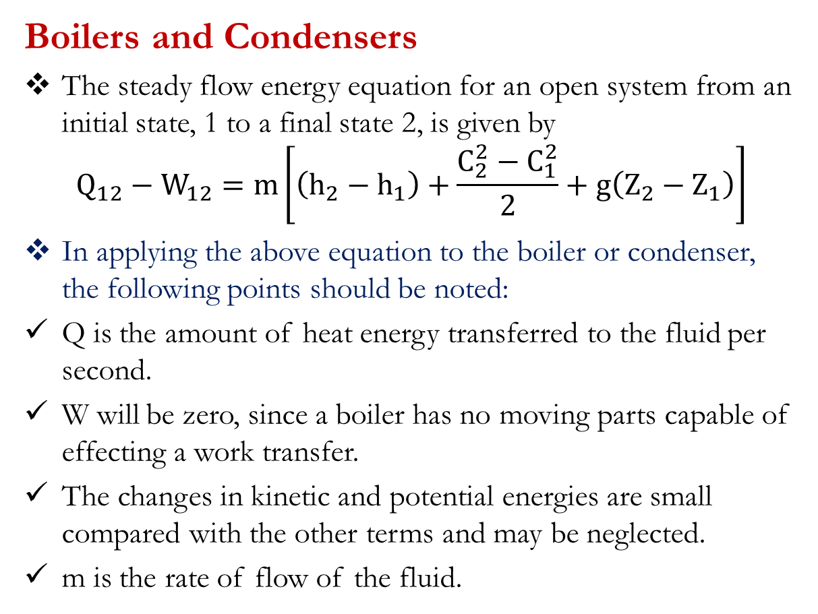
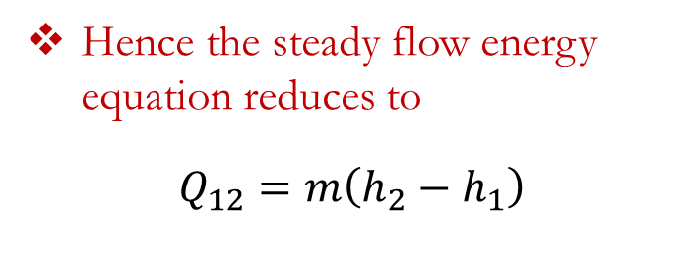
Applications of steady flow energy equation
Boilers and Condensers
The steady flow energy equation for an open system from an initial state, 1 to a final state 2, is given by
$$Q_{12}−W_{12}=m\left[\left(h_{2}−h_{1}\right)+\frac{C_{2}^{2}−C_{1}^{2}}{2}+g\left(Z_{2}−Z_{1}\right)\right]$$
In applying the above equation to the boiler or condenser, the following points should be noted:
Q is the amount of heat energy transferred to the fluid per second.
W will be zero, since a boiler has no moving parts capable of effecting a work transfer.
The changes in kinetic and potential energies are small compared with the other terms and may be neglected.
m is the rate of flow of the fluid.
Hence the steady flow energy equation reduces to
$$Q_{12}=m\left(h_{2}−h_{1}\right)$$

Slide 22
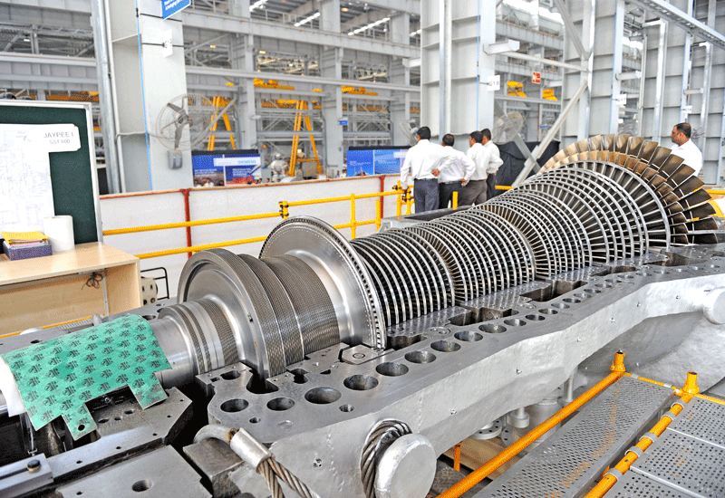
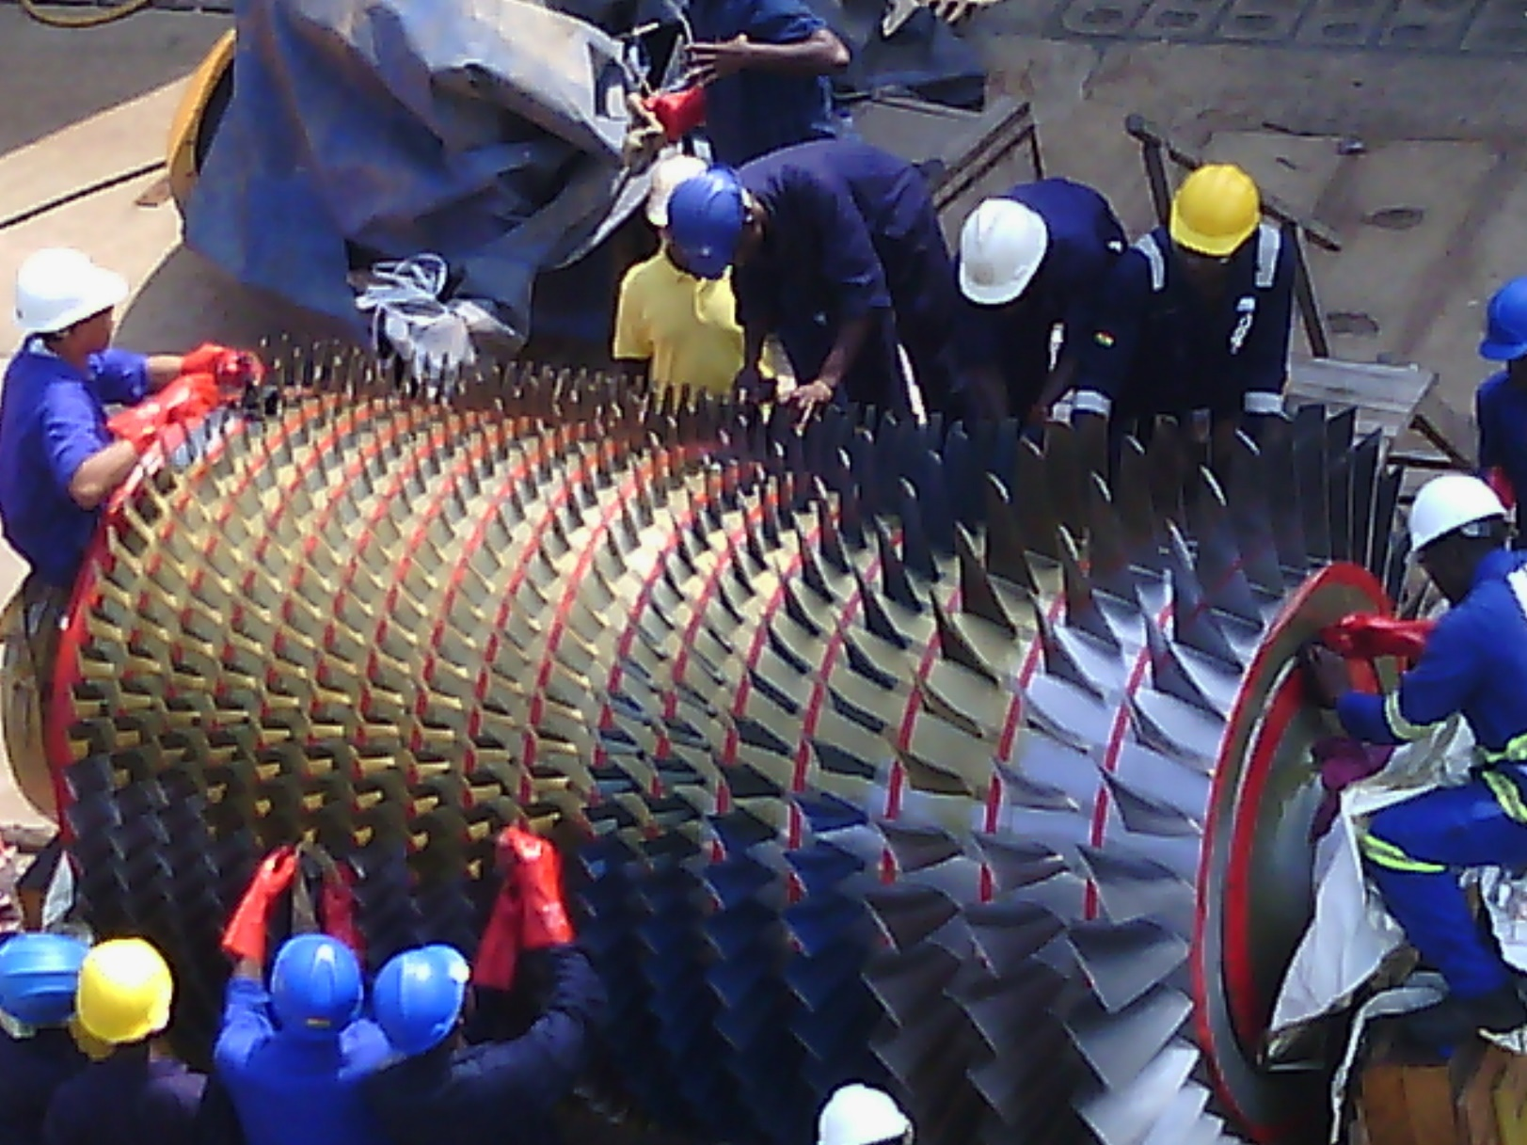
Applications of steady flow energy equation
Turbines and Compressors
A turbine is a device which uses a pressure drop to produce work energy which is used to drive an external load.
The action of a compressor is the reverse of a turbine. It uses external work energy to produce a pressure rise.

Slide 23
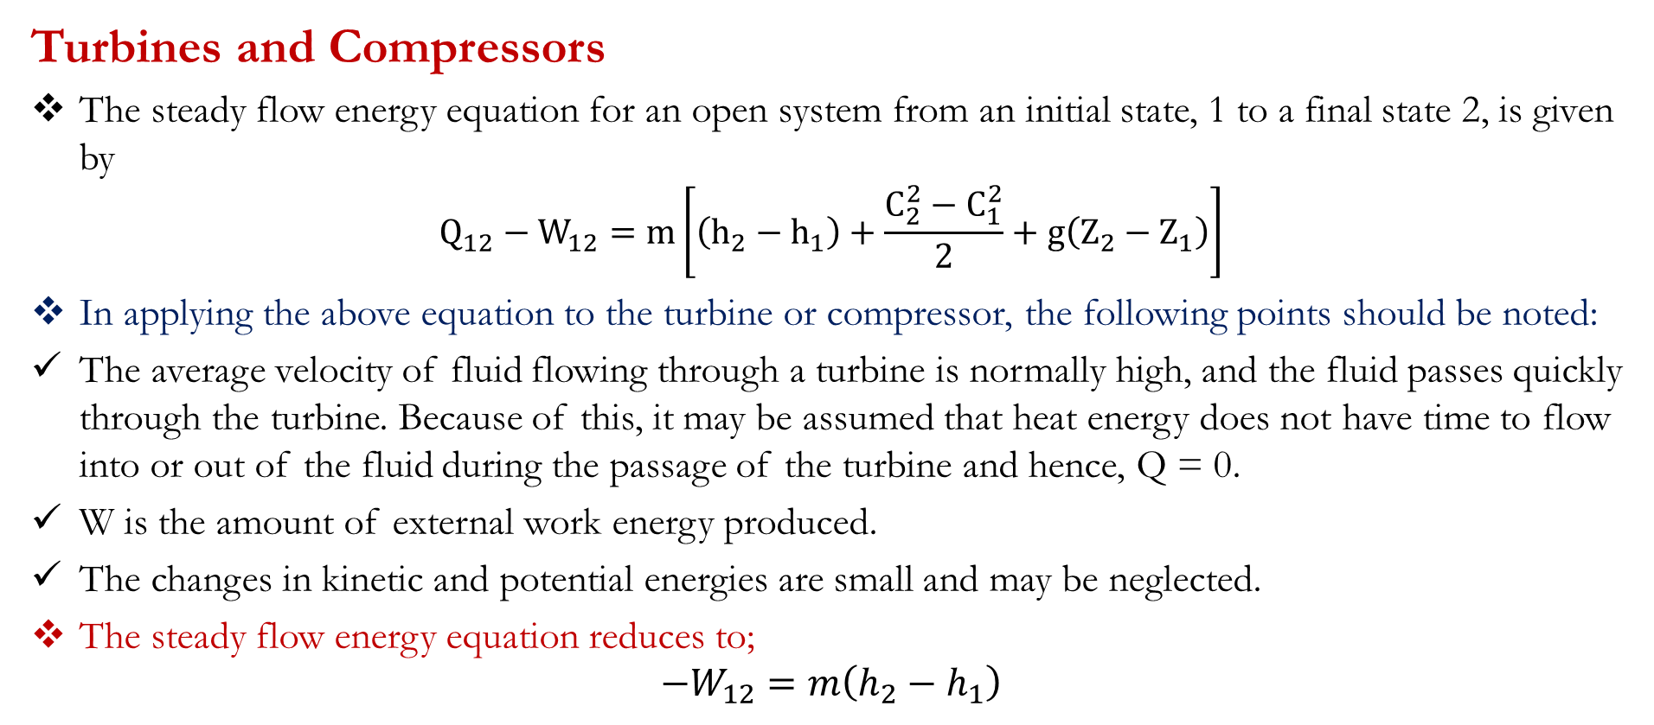
Applications of steady flow energy equation
Turbines and Compressors
The steady flow energy equation for an open system from an initial state, 1 to a final state 2, is given by
$$Q_{12}−W_{12}=m\left[\left(h_{2}−h_{1}\right)+\frac{C_{2}^{2}−C_{1}^{2}}{2}+g\left(Z_{2}−Z_{1}\right)\right]$$
In applying the above equation to the turbine or compressor, the following points should be noted:
The average velocity of fluid flowing through a turbine is normally high, and the fluid passes quickly through the turbine. Because of this, it may be assumed that heat energy does not have time to flow into or out of the fluid during the passage of the turbine and hence, Q = 0.
W is the amount of external work energy produced.
The changes in kinetic and potential energies are small and may be neglected.
The steady flow energy equation reduces to;
$$−W_{12}=m\left(h_{2}−h_{1}\right)$$

Slide 24
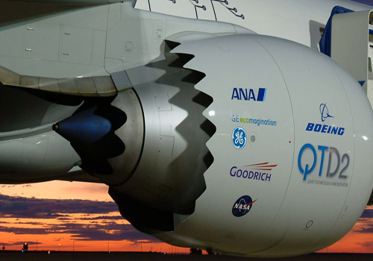
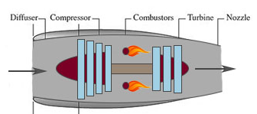
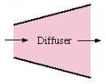
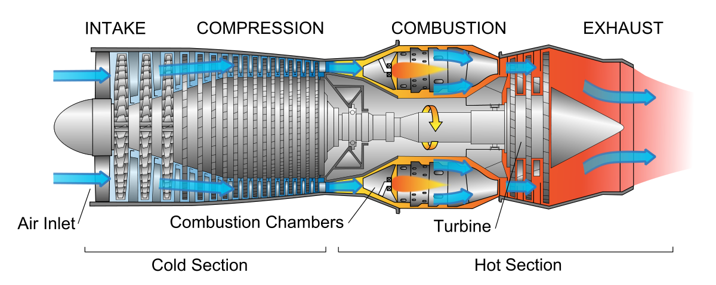
Applications of steady flow energy equation
Nozzles and Diffusers
A nozzle is a device which utilizes a pressure drop to produce an increase in the velocity (kinetic energy) of the fluid.
The action of a diffuser is the reverse of a turbine. It increases the pressure of the fluid at the expense of its velocity

Slide 25
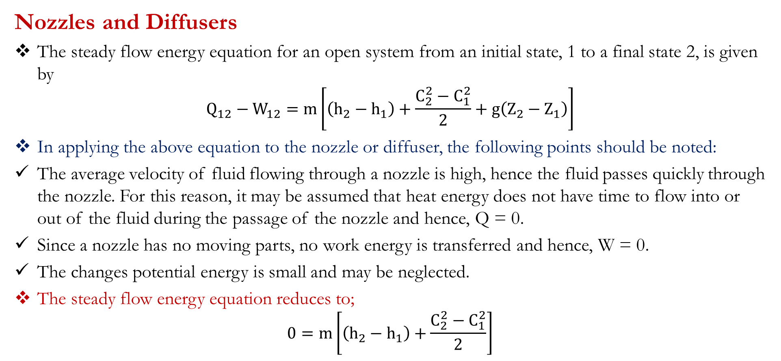
Applications of steady flow energy equation
Nozzles and Diffusers
The steady flow energy equation for an open system from an initial state, 1 to a final state 2, is given by
$$Q_{12}−W_{12}=m\left[\left(h_{2}−h_{1}\right)+\frac{C_{2}^{2}−C_{1}^{2}}{2}+g\left(Z_{2}−Z_{1}\right)\right]$$
In applying the above equation to the nozzle or diffuser, the following points should be noted:
The average velocity of fluid flowing through a nozzle is high, hence the fluid passes quickly through the nozzle. For this reason, it may be assumed that heat energy does not have time to flow into or out of the fluid during the passage of the nozzle and hence, Q = 0.
Since a nozzle has no moving parts, no work energy is transferred and hence, W = 0.
The changes potential energy is small and may be neglected.
The steady flow energy equation reduces to;
$$0=m\left[\left(h_{2}−h_{1}\right)+\frac{C_{2}^{2}−C_{1}^{2}}{2}\right]$$

Slide 26
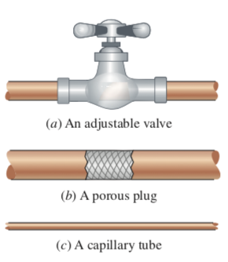
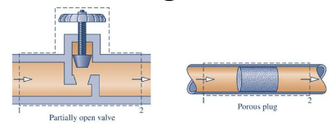
Applications of steady flow energy equation
Throttling Devices
A throttling device is a device that achieves a significant reduction in pressure by introducing a restriction into a line through which a gas or liquid flows.
The means to introduce the restriction include a partially opened valve or a porous plug.

Slide 27
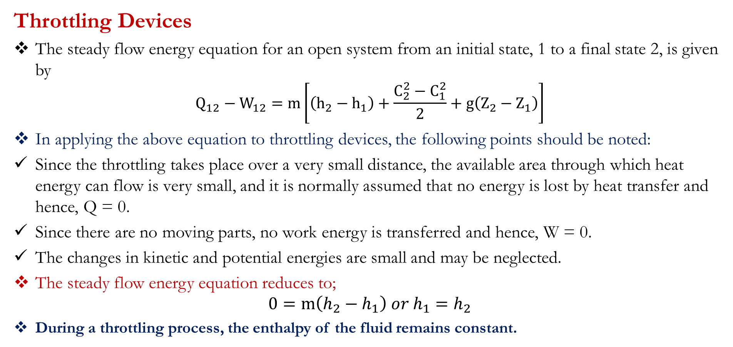
Applications of steady flow energy equation
Throttling Devices
The steady flow energy equation for an open system from an initial state, 1 to a final state 2, is given by
$$Q_{12}−W_{12}=m\left[\left(h_{2}−h_{1}\right)+\frac{C_{2}^{2}−C_{1}^{2}}{2}+g\left(Z_{2}−Z_{1}\right)\right]$$
In applying the above equation to throttling devices, the following points should be noted:
Since the throttling takes place over a very small distance, the available area through which heat energy can flow is very small, and it is normally assumed that no energy is lost by heat transfer and hence, Q = 0.
Since there are no moving parts, no work energy is transferred and hence, W = 0.
The changes in kinetic and potential energies are small and may be neglected.
The steady flow energy equation reduces to;
$$0=m\left(h_{2}−h_{1}\right) or h_{1}=h_{2}$$
During a throttling process, the enthalpy of the fluid remains constant.

Slide 28
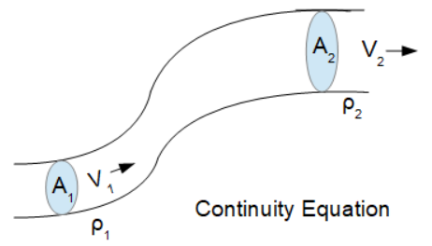
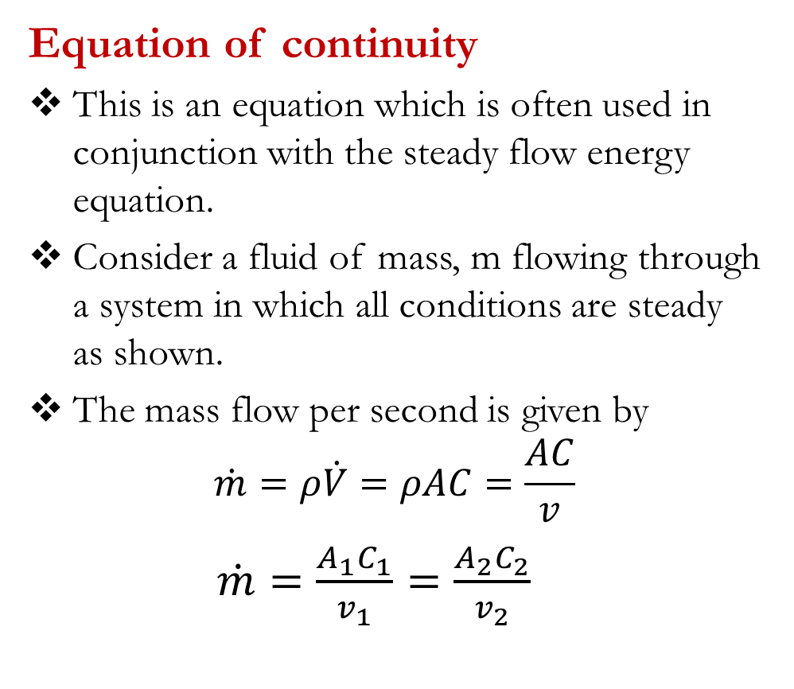
First Law of Thermodynamics: Open system
Equation of continuity
This is an equation which is often used in conjunction with the steady flow energy equation.
Consider a fluid of mass, m flowing through a system in which all conditions are steady as shown.
The mass flow per second is given by
$$\dot{m}=ρ\dot{V}=ρAC=\frac{AC}{v}$$
$\dot{m}=\frac{A_{1}C_{1}}{v_{1}}=\frac{A_{2}C_{2}}{v_{2}}$

Slide 29
First Law for Open Systems: Problems
Problem 1
A boiler operates at a constant pressure of 15 bar, and evaporates fluid at the rate of 1000 kg/h. At entry to the boiler, the fluid has an enthalpy of 165 kJ/kg, and on leaving the boiler, the enthalpy of the fluid is 2200 kJ/kg. the outlet pipe from the boiler is at a height of 16 m above the inlet pipe, and the inlet and outlet velocities of the fluid are 13 m/s and 33 m/s respectively. Determine the rate of heat energy transferred to the boiler.
Suggested answer: [565.3 kW]
Problem 2
A fluid flows through a turbine at the rate of 45 kg/min. Across the turbine, the specific enthalpy drop of the fluid is 580 kJ/kg and the turbine loses 2100 kJ/min in the form of heat energy. Determine the power produced by the turbine, assuming that changes in kinetic energy and potential energy may be neglected.
Suggested answer: [400 kW]

Slide 30
First Law for Open Systems: Problems
Problem 3
A compressor delivers fluid at a rate of 45 kg/min. At the inlet to the compressor, the specific enthalpy of the fluid is 46 kJ/kg, and at outlet from the compressor, the specific enthalpy of the fluid is 175 kJ/kg. If 105 kJ/min of heat energy are lost to the surroundings by the compressor, determine the power required to drive the compressor.
Suggested answer: [98.5 kW]
Problem 4
Fluid with a specific enthalpy of 2800 kJ/kg enters a horizontal nozzle with negligible velocity at a rate of 14 kg/s. At the outlet from the nozzle, the specific enthalpy and specific volume of the fluid are 2250 kJ/kg and 1.25 m³/kg respectively. Assuming adiabatic flow, determine the required outlet area of the nozzle.
Suggested answer: [0.01668 m²]

Slide 31
First Law for Open Systems: Problems
Problem 5
A fluid flowing along a pipe line undergoes a throttling process from 10 bar to 1 bar in passing through a partially open valve. Before throttling, the specific enthalpy of the fluid is 0.3 m³/kg and after throttling is 1.8 m³/kg. determine the change in specific internal energy of the fluid during the throttling process.
Suggested answer: [120 kJ/kg]

Slide 32

KNUST-SESC

